Slide 1
Ethics in Analytics
Shea Parkes, FSA MAAA

Slide 2
Limitations
The views expressed in this presentation are those of the presenter, and not those of Milliman or the Society of Actuaries. Nothing in this presentation is intended to represent a professional opinion or be an interpretation of actuarial standards of practice.

Slide 3
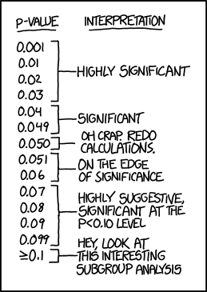
P-Values by Randal Monroe
https://xkcd.com/1478/

Slide 4
P-Values by Randal Monroe
https://xkcd.com/1478/

Slide 5
Researcher Degrees of Freedom
False-Positive Psychology – Joseph Simmons et al
[I]t is unacceptably easy to publish “statistically significant” evidence consistent with any hypothesis.
The culprit is a construct we refer to as researcher degrees of freedom. In the course of collecting and analyzing data, researchers have many decisions to make:
Should more data be collected?
Should some observations be excluded?
Which conditions should be combined and which ones compared?
Which control variables should be considered?
Should specific measures be combined or transformed or both?

Slide 6
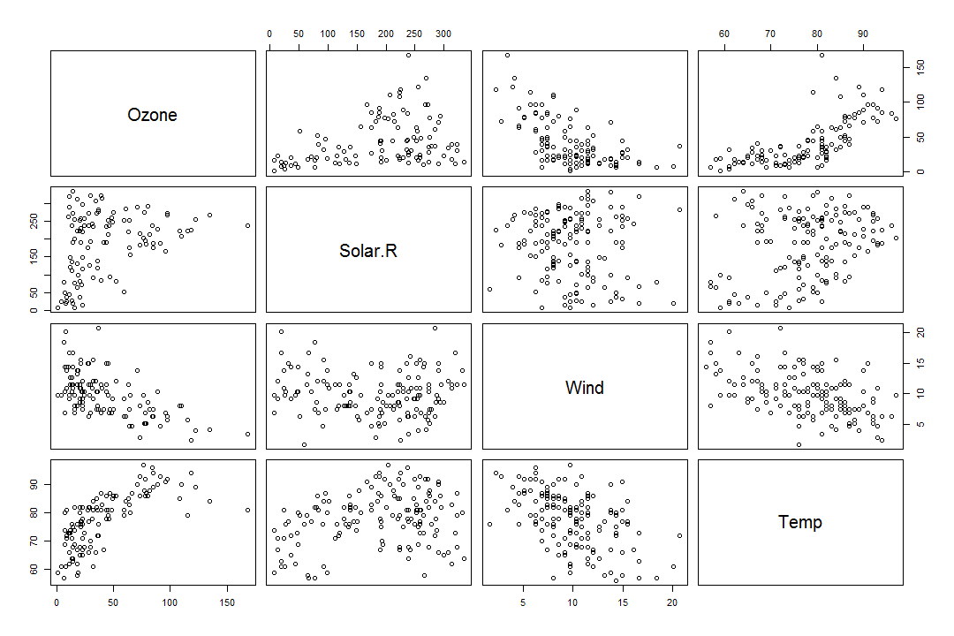
Researcher Degrees of Freedom
pairs(airquality[,c('Ozone', 'Solar.R', 'Wind', 'Temp')])

Slide 7
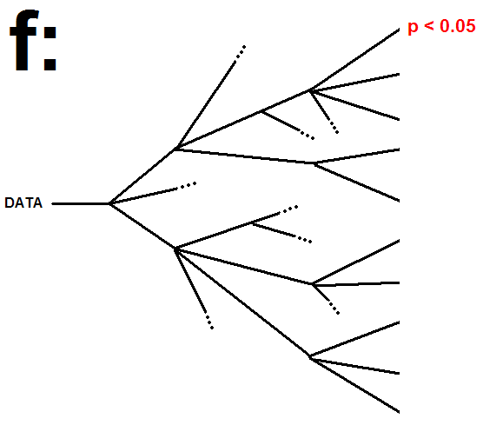
Forking Paths
http://blogs.discovermagazine.com/
neuroskeptic/2013/10/16/the-f-problem/

Slide 8
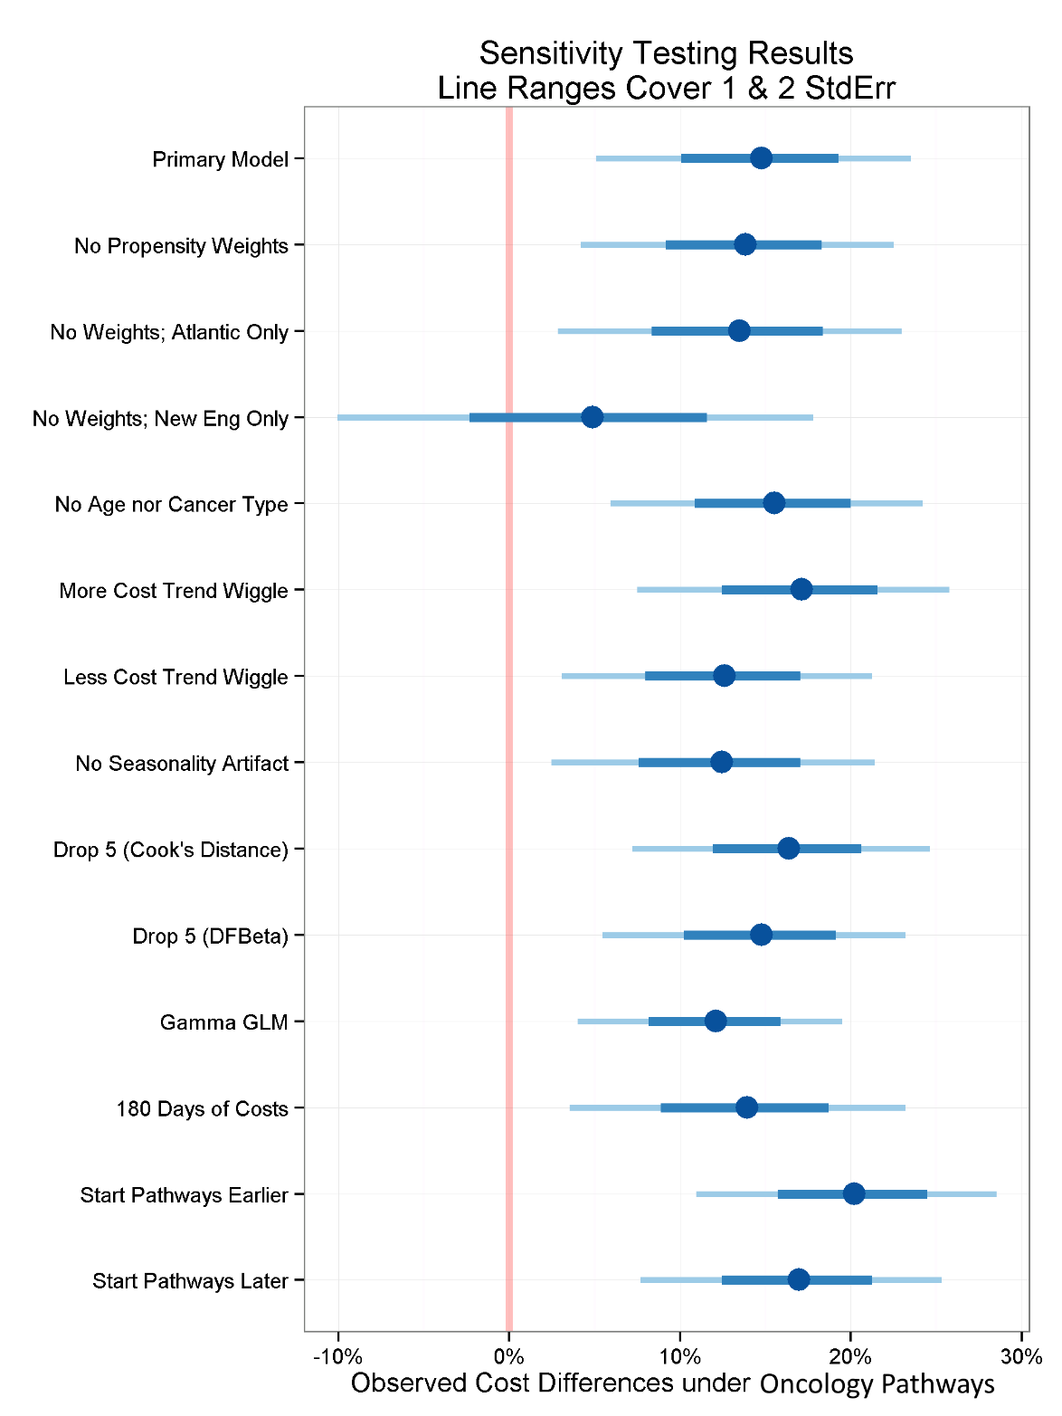
Forking Paths
http://blogs.discovermagazine.com/
neuroskeptic/2013/10/16/the-f-problem/

Slide 9
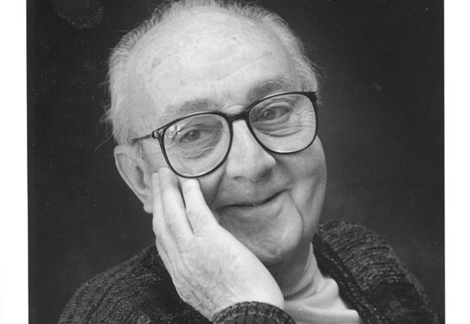
George E. P. Box
All models are wrong, but some are useful.
Statisticians, like artists, have the bad habit of falling in love with their models.

Slide 10
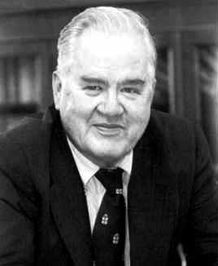
John Tukey
All we know about the world teaches us that the effects of A and B are always different---in some decimal place---for any A and B. Thus asking "are the effects different?" is foolish.

Slide 11

Big Data and Null Hypothesis Significance Testing

Slide 12
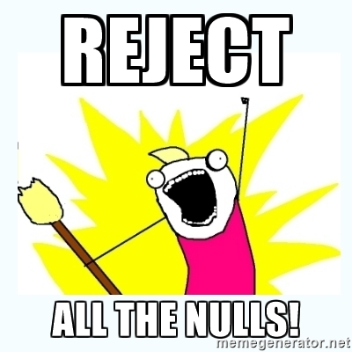
Big Data and Null Hypothesis Significance Testing

Slide 13
The ASA's statement on p-values
Ronald Wasserstein and Nicole Lazar (2016)
P-values can indicate how incompatible the data are with a specified statistical model.
P-values do not measure the probability that the studied hypothesis is true, or the probability that the data were produced by random chance alone.
Scientific conclusions and business or policy decisions should not be based only on whether a p-value passes a specific threshold.
Proper inference requires full reporting and transparency.
A p-value, or statistical significance, does not measure the size of an effect or the importance of a result.
By itself, a p-value does not provide a good measure of evidence regarding a model or hypothesis.

Slide 14
Stepwise Regression Considered Harmful
Regression Strategies – Frank Harrell
It yields R-squared values that are badly biased to be high.
The F and chi-squared tests quoted next to each variable on the printout do not have the claimed distribution.
The method yields confidence intervals for effects and predicted values that are falsely narrow; see Altman and Andersen (1989).
It yields p-values that do not have the proper meaning, and the proper correction for them is a difficult problem.
It gives biased regression coefficients that need shrinkage (the coefficients for remaining variables are too large; see Tibshirani [1996]).
It has severe problems in the presence of collinearity.
It is based on methods (e.g., F tests for nested models) that were intended to be used to test prespecified hypotheses.
Increasing the sample size does not help very much; see Derksen and Keselman (1992).
It allows us to not think about the problem.

Slide 15
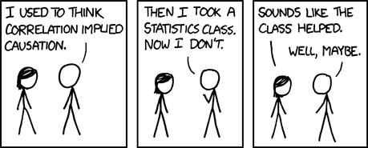
Correlation by Randal Monroe
https://xkcd.com/552/

Slide 16
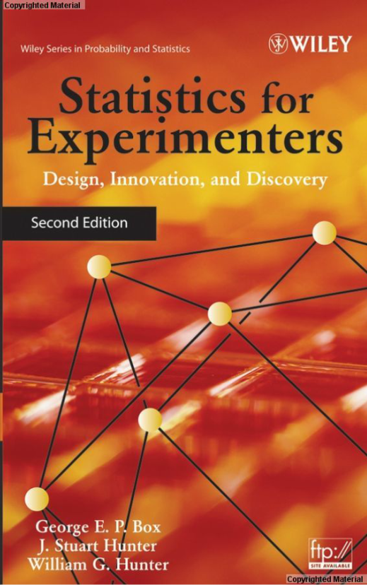
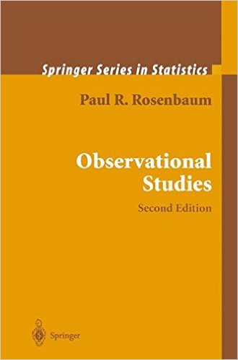
Experimental vs Observational

Slide 17
Thank you
Shea Parkes, FSA MAAA
Shea.Parkes@milliman.com

